Slide 1
Building APIs in Rails

Slide 2
Learning Goals
Understand how an API works at a conceptual level
Use request specs to TDD an API
Understand what makes a valid JSON data structure
Learn how to parse and create JSON in Ruby

Slide 3
Warm Up
What is an API in the context of web development?
Why might we decide to expose information in a database we control through an API?
What do we need to test in an API?
How will our tests be different from feature tests we have implemented in the past?
What is REST and why do we need it?

Slide 4
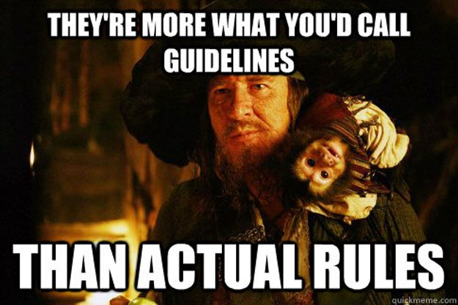
Rest
Representational State Transfer
Ties together the idea of HTTP verbs and URI paths/routes into a uniform interface
Language Agnostic
Developers have some flexibility
REST in Rails
Easy to draw comparison of controller actions to HTTP verbs

Slide 5
APIs and Why we use them
API = Application Program Interface
Transmit Data without HTML overhead
Provide Service for other companies
Split the work of our application service into smaller application services that are each deployed separately (service-oriented architecture)

Slide 6
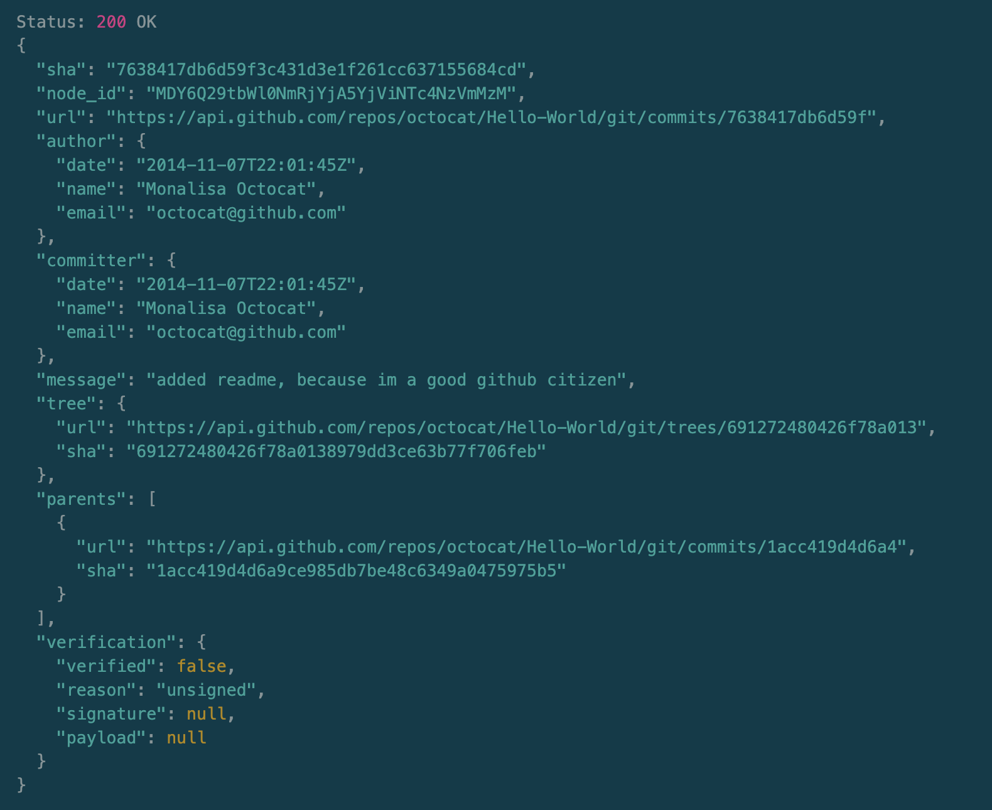
JSON as Response

Slide 7
Converting Ruby Hashes to JSON
my_hash = { greeting: ‘hello’ }
JSON.generate(my_hash)
#=> “{ “greeting”: “hello” } ”
my_hash.to_json
#=> “{ “greeting”: “hello” } ”

Slide 8
Building APIs in Rails
-- api (flag to use when creating a new project)
Namespacing and Routing
“versioning” our routes
api/v1/puppies
Controllers no longer call a view for HTML
render json: Puppy.all

Slide 9
Testing APIs
get 'api/v1/items'
submits a get request to your application (like visit, but without all of the Capybara bells and whistles)
response
captures the response to a given request (like page when using Capybara)
JSON.parse(response)
parses a JSON response

Slide 10
Time for Exploration

